Slide 1
Engagement ISDC Sponsored First Thursday Event
Notes:
[Angie (Libraries)]

Slide 2
WHY ENGAGEMENT?
Unconference
Communication/Collaboration
Leadership
DICE
Strategic Plan 2010
Notes:
[Angie (Libraries)]
DICE: primary IS catchphrase is "Delivery, Innovation, Capacity, and Engagement." Thus, our decision to focus on "engagement" accords with our organization's larger goals.

Slide 3
Outline
WHY
WHAT
Defining our terms
HOW and WHEN
Assessing ourselves
WHERE
Next steps, opportunities
Notes:
[Angie (Libraries)]

Slide 4
WHAT IS ENGAGEMENT?
Group 1: What do you see when you see engagement?
open arms
eye contact
smiles/focused attention
healthy conversation
people talking/gathered together
enthusiasm
access to management/interaction between management and staff
fun and passion are visible/stress is less visible
low cubicle walls (an example of work space designed to maximize engagement and collaboration)
blogs/wikis provide access to information and interaction
Group 2: What do you hear when you hear engagement?
open dialogue/communication
positive collaboration
more than one person talking
noise
people offering solutions
brainstorming
team-building exercises
offers of help
laughter
cooperation
emotion/passion
camaraderie/cooperation
statements like "I think..." or "I feel..."
courtesy
caring
positive reinforcement/acknowledgment
reaching across boundaries
understanding work flow/hiearchies
lateral communication
questions being asked
spontaneous fun
Group 3 : What do you think/feel when you experience engagement?
focused
part of a group
excitement
inspired
energized
satisfied
organized
that success is a worthwhile pursuit
Notes:
[Kathleen (HREO)]

Slide 5
Greatness in Action Muhammad Yunus
Discussion (see wiki for more discussion)
The group felt that Muhammad Yunus's high level of engagement was evident by:
his passion
his realization that there was a need to address
his conscience
his talent
his curiosity
his belief in people
his vision
his testing of assumptions
Notes:
[Kathleen (HREO)]

Slide 6
HOW AND WHEN ARE WE ENGAGED?
Engagement Self –Assessment
How engaged are you
on a good day?
W - WORK
P - PERSONAL
Somewhat Engaged
Positively Engaged
Negatively Engaged
Disengaged
Notes:
[Angie (Libraries)]
Place the W and P and answer the questions on the form. Note: this will not be shared with anyone. This is YOUR individual assessment. The questions will help us when we discuss barriers and helps in work and personal life, but you don’t have to share these specifically, either.

Slide 7
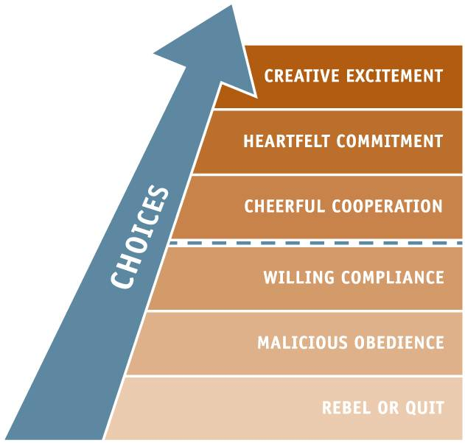
Barriers? Helps? Choices?
Where are you and the people on your team?
How much of your talent, passion, and commitment are you volunteering?
Notes:
[Kathleen (HREO)]
Discussion of the tool here. Use this slide to help move from barriers and helps to the choices we make in response to them.
Some (more) questions to stimulate discussion:
- How do people demonstrate engagement? or How do others know you are engaged?
- What is it about people that enables them to be engaged? (we would like this to focus on attitudes, not skills or knowledge because attitudes can be adopted by everyone)
- What is it about people that causes them to be less engaged?
What can people do to increase their own level of engagement?
What can people do to enable others to be more engaged?
-How can individuals become more engaged with ISDC?
-What is ISDC doing to engage IS staff? (these don't require audience input)

Slide 8
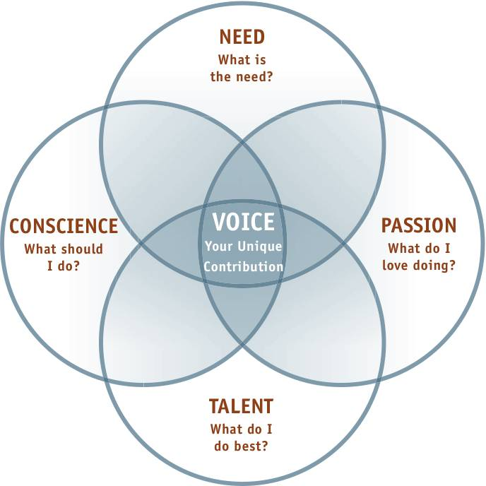
HOW AND WHERE CAN I GET ENGAGED?
I plan to engage differently in my work or personal life by…
Notes:
[Kathleen (HREO)]
The point is to find peoples unique talents and distill that into their highest contribution that they are passionate to give. The tools to do this are just like the tools you used for yourself earlier.

Slide 9
HOW AND WHERE CAN I GET ENGAGED?
IS Development Council Wiki https://apps.ku.edu/~intralib/index.php/IS_Development_Council_main_page
IS Suggestion Box https://www2.ku.edu/~iserv/cgi-bin/suggestionbox/comment.php
Gallup’s Q12 – Twelve questions to measure employee engagement http://www.workforce.com/section/09/article/23/53/40.html
Gallup Management Journal – Engagement Blog http://gmj.gallup.com/tag/Employee%20Engagement.aspx
Supervisor Resources
Leadership (HREO) resources
ISDC Task Forces
communication
wiki
Notes:
[Mike (Libraries HR)/Andrea (IT HR)]: Talk about the resources listed at the bottom of the distributed tool (and above left)
[Mike]: Mention what you’re doing with Supervisors in the Libraries
[Andrea]: Talk about HREO and what’s happening for IT side.
[Angie(Libraries)] : Talk about what ISDC is planning next.

Slide 10
What did you think?
Please take time to complete an assessment of this event for ISDC.

